Slide 1
HPE OSS Performance Management
JS & Neo4J
Zhigang Yan
Jan10th, 2016
Notes:
This is a sample Title Slide with Picture ideal for including a dark picture with a brief title and subtitle.
A selection of pre-approved title slides are available in the HPE Title Slide Library. The location of the library will be communicated later.
To insert a slide with a different picture from the HPE Title Slide Library:
Open the file HPE_16x9_Title_Slide_Library.pptx
From the Slide thumbnails pane, select the slide with the picture you would like to use in your presentation and click Copy (Ctrl+C)
Open a copy of the new HPE 16x9 template (Standard or Events) or your current presentation
In the Slide thumbnails pane, click Paste (Ctrl+V)
A Paste Options clipboard icon will appear. Click the icon and select Keep Source Formatting. (Ctrl+K)

Slide 2
General Ideas
This is a light but extendible solution of performance management.
The solution bases on Neo4J database, which provides high performance on massive data and used by other HPE product like UCA.
In the prototype all modules are developed in JavaScript (NodeJS & AngularJS), while for customized collectors, they can developed in JAVA or Scala.
Most function modules work independently, they all provide REST APIs for CONTROL and MONIOR
Due to limit of V8(NodeJS) to deal with huge data, it has to split the collector into several collectors work parallel, these collector can run in a distribution environment
Only raw counters are stored in the Neo4J, all calculations are runtime. (depends on the performance of Neo4J)
Jobs are executed by scheduler. The jobs are:
Calculate/Get KPIs have thresholds
Trigger the actions if thresholds are broken
Data retention
Retention, it’s could calculate the history KPI values (for all types of KPI) into an achieve DB.
The GUI is develop on HPE UOC framework.
Report Packs are not developed in the prototype. UOC or other tools like Pentaho can be used to develop reports. KPI engine will provide APIs to query KPI values.

Slide 3
Architecture – Function View
GUI
KPI/Threshold Management
Collector Monitor and Management
Model Designer
CORE
Definitions:
Model, KPI, Threshold
Data:
Raw counters
KPI Engine
Threshold Engine(Condition/
Action)
NEO4J
JOB Management
Achieve
Collectors
SNMP Collector
CSV Collector
more Collectors

Slide 4

Architecture – Deploy view
Neo4J Cluster
GUI (UOC) Server
Writer Master
Read Slaves
Collector Servers
MPM Core Server

Slide 5
Architecture – Service View (prototype)
Web GUI Client
KPI Manage Widgets
Collector Manage Widget
Threshold Manage Widget
Model Designer
REST
Web GUI Server
MPM Plugin
REST
REST
KPI Engine
Threshold Engine(Condition/
Action)
NEO4J
REST
JOB Management
Achieve
SNMP Collector
Standard CSV Collector
Not in the prototype

Slide 6
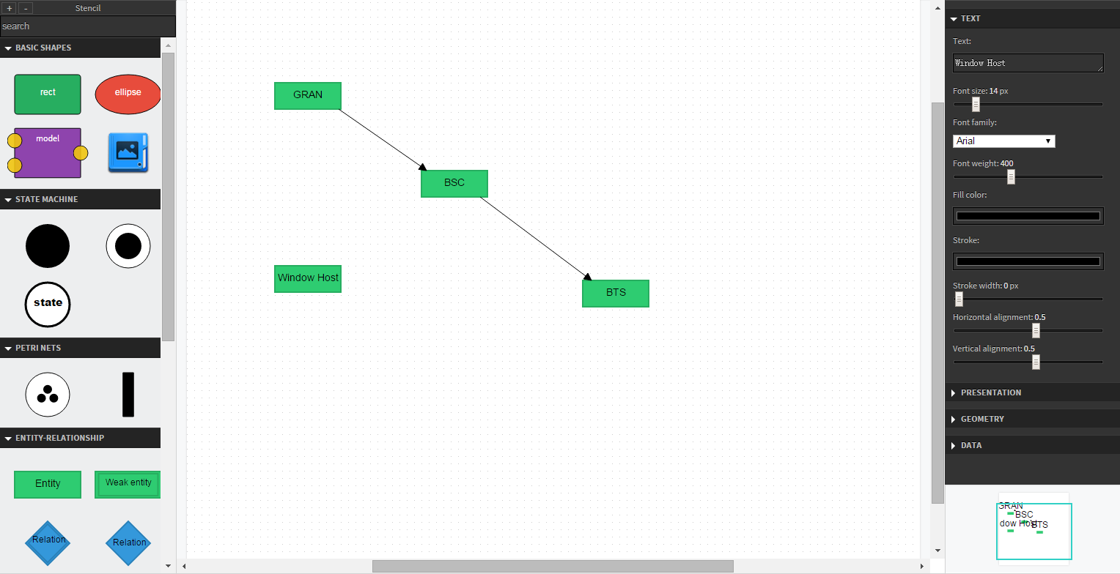
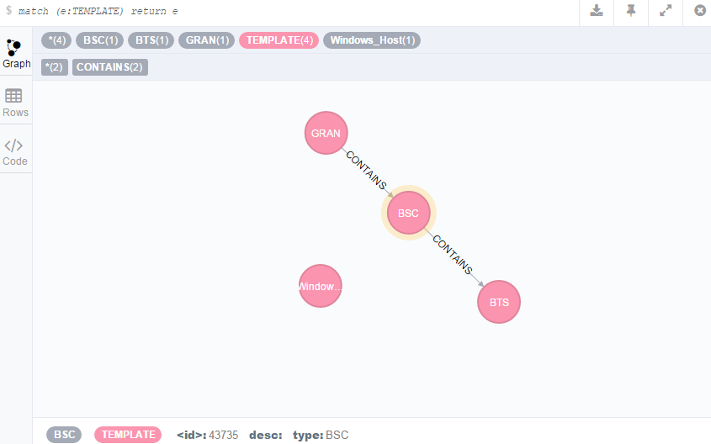
Design Model
The monitored network shall have a model. The model consists of NE nodes and relationships.
Model Designer
Build a visualized designer to define the model of network based on RAPPID library.
Granularity objects are defined in the designer as well.
Model in DB

Slide 7
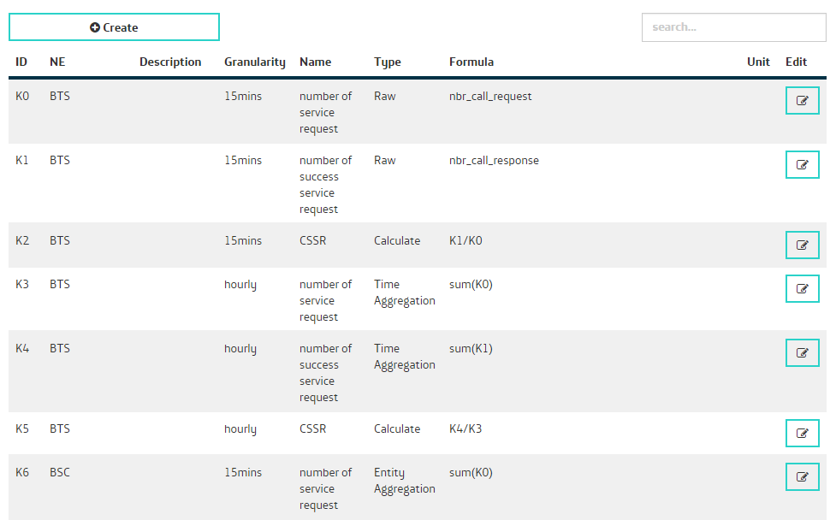
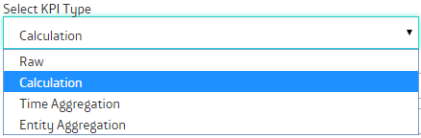
KPI Management -- create and manage KPI definitions
Each KPI has a unique ID assigned by the system.
There are 4 types of KPI
Raw: collect by the collectors.
Calculation: The KPI is calculated based on the KPIs of the same NE and have the same granularity.
Time Aggregation: The KPI is aggregated by the KPI of the same NE type but from smaller granularity.
Entity Aggregation: The KPI is aggregated by the KPI of the sub NE (defined in the model) and have same granularity.
These 4 types shall meet all the KPI requirements, but we still able to enhance it to simplify the types and support more complex formula and support more aggregation functions.

Slide 8
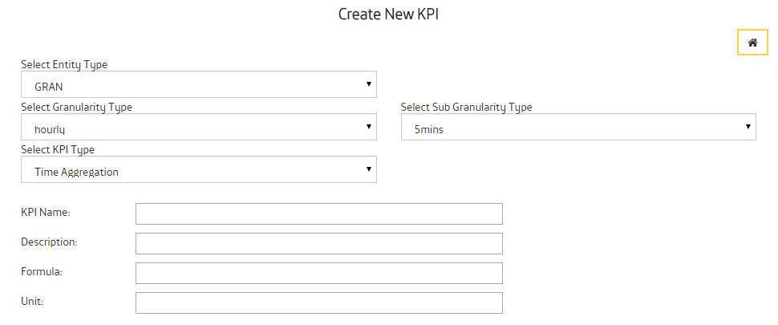
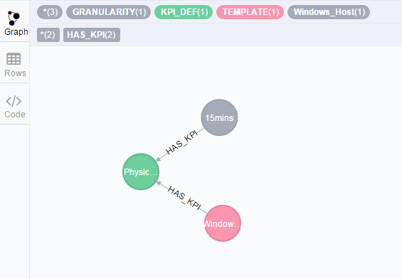
KPI Definition in Database
Each KPI_DEF node must connect to one NE template node and one Granularity definition node.

Slide 9
KPI Engine
KPI Engine module is the most valuable module in the system which reflects most important design ideas.
One idea is only store RAW counters/KPIs in the DB, all other KPIs are calculate in runtime. It’s because of in PM collection, the collection and aggregation are running in schedule, while some raw data may comes later, so the aggregation data may not accurate, it’s difficult to update these data. While calculate in runtime is the other side of devil which may encounter performance issue. So current design and prototype may not suit for the real time scenario with lots calculations.
A third part library is included to pares and calculate the Calculation KPI( also used by Threshold module and SNMP collector)
Only support follow aggregation method: sum, avg, max, min and count. (in SNMP collector support these methods and one more: delta)
The engine provide customized APIs to fetch KPI values

Slide 10
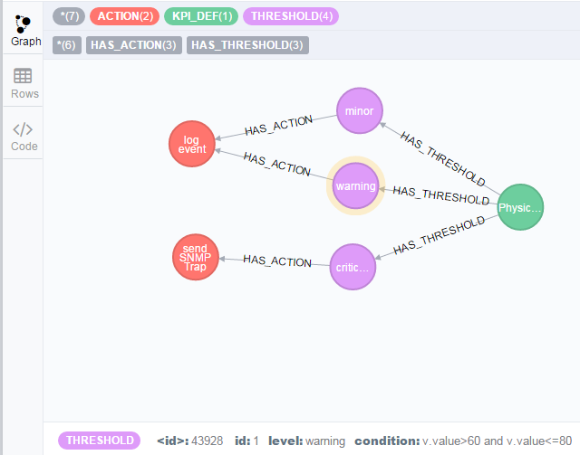
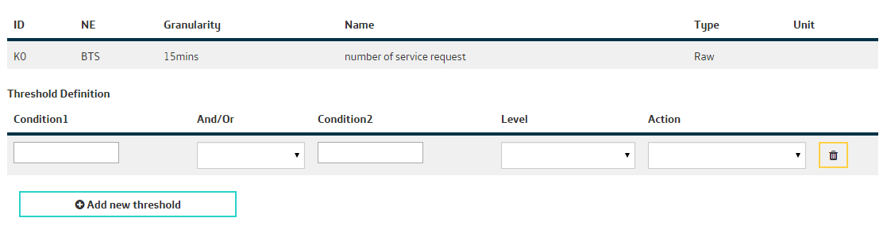
Threshold Management
Each KPI Definition has one or more Threshold definitions.
Each definition has one condition and a Action
The Condition must be a logical expression.
The Action could be various types, but the action module is not develop in the prototype.
Threshold engine will get the KPI values (get from DB if the KPI type is Raw or invoke KPI engine to calculate the KPI values) and check if it’s broke the condition.
The threshold engine shall be invoke by a Job system which is not in the prototype.

Slide 11
Standard CSV Collector
The collector will monitor a configuration directory and consumes new files.
The file must in a defined format. So it’s required a external simple ETL application to reform the source files.
The file must have headers.
After collect successfully, the file will be renamed or removed.
KPI must be defined before collecting
Inventory data may come together with performance file or need another collector to collect from inventory system.
<Parent Type> | <Ne Type> | Timestamp | Granularity | <KPI Name1> | <KPI Name2> | …
BSC1 | BTS1 | 148237847383 | 500 | 348 | NA | …

Slide 12
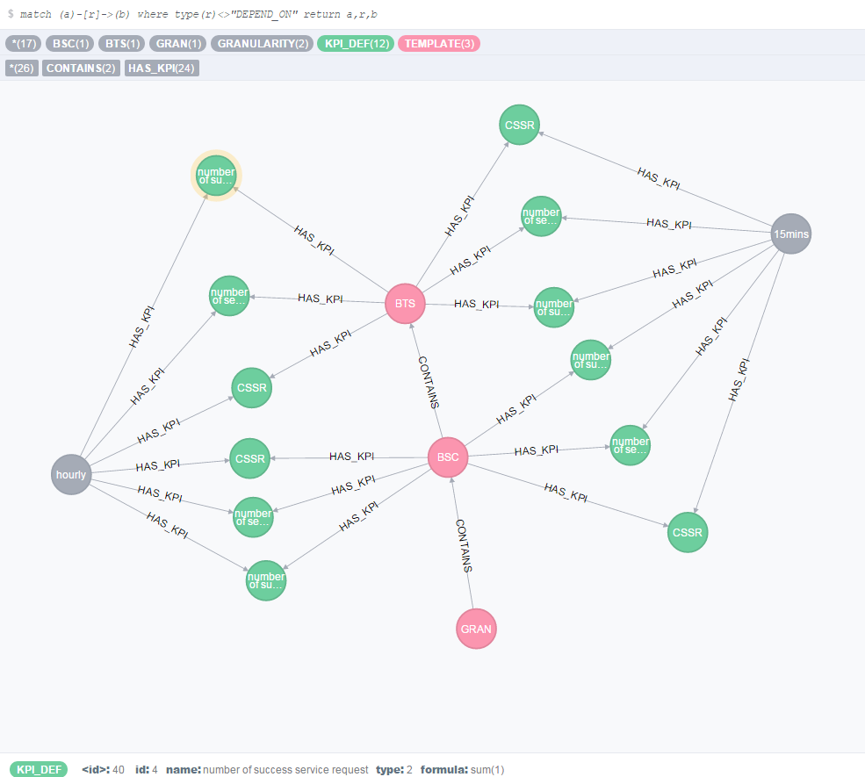
E2E Scenario definitions

Slide 13
Source file
merge (:TEMPLATE:BSC {type:"BSC",desc:""}); merge (:TEMPLATE:BTS {type:"BTS",desc:""});
merge (:KPI_DEF {id:0,name:"number of service request",type:0,formula:"nbr_call_request"});
merge (:KPI_DEF {id:1,name:"number of success service request",type:0,formula:"nbr_call_response"});
BSC,BTS,TS,GRANULARITY,nbr_call_request,nbr_call_response BSC1,BTS1,100000000000,900,1,2 BSC1,BTS1,100000900000,900,1,2 BSC1,BTS1,100001800000,900,1,2 BSC1,BTS1,100002700000,900,1,2 BSC1,BTS2,100000000000,900,1,2 BSC1,BTS2,100000900000,900,1,2 BSC1,BTS2,100001800000,900,1,2 BSC1,BTS2,100002700000,900,1,2
CSV file
merge (:GRANULARITY {id:0,type:"15mins",num:900});

Slide 14
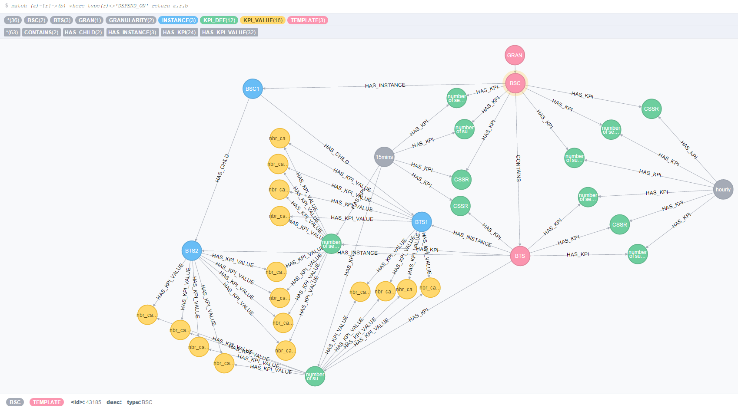
After collect

Slide 15
CSV Collector Performance Test
Test environment:
zbook 15, 8 CPU (i7-4800) ,Memory 32G, OS: windows 7;
Neo4J 2.3.1 community version with default setting
NodeJS v5.2.0
Test 1, simulate one csv file with 10BSC, each BSC has 100 BTS, total 10000 records , each record has 12 KPI value.
Cost 328 seconds
Test 2 simulate 10 csv files, each file has 1BSC 100 BTS 1000 records, each record has 12 KPI value.
Cost 35, 67, 100, 134, 168, 201,235, 302, 339, seconds
It seems the Neo4J is working in serial, 10000 KPIs cost 30 seconds.
Note: 1) During the test, the CPU loading is less than 50% and there is still lots free memory. Also query in the Neo4J console is fast. 2) Need study the configuration of Neo4J.

Slide 16
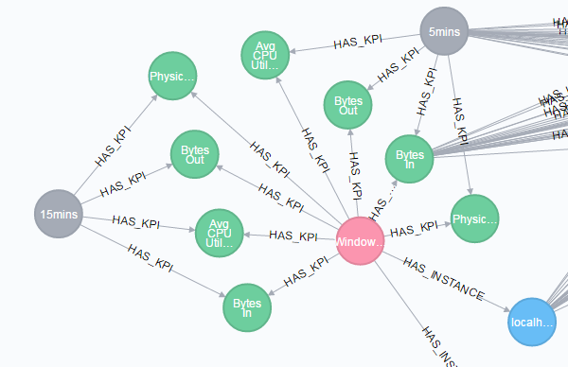
SNMP Collector
SNMP can collect data by snmpget or snmpwalk.
The SNMP collector has a configuration file which define the host and collection OIDs.
Different with CSV collector:
The SNMP collector will register the KPIs in by itself
The KPI could be calculated or aggregated before ingestion.
"device_info": { "type": "Windows_Host", "name": "localhost", "IP": "127.0.0.1", "community": "public", "version": "2c" }, "OIDs": [ { "method": "get", "name": "Physical memory utilization", "formula": "[.1.3.6.1.2.1.25.2.3.1.6.4]/[.1.3.6.1.2.1.25.2.3.1.5.4]*100", "unit":"%", "interval": 300 }, { "method": "walk", "aggregation": "avg", "name": "Avg CPU Utilization", "formula": "[.1.3.6.1.2.1.25.3.3.1.2]", "description":"Average CPU Utilization in 5 minutes", "unit":"%", "interval": 300 },

Slide 17
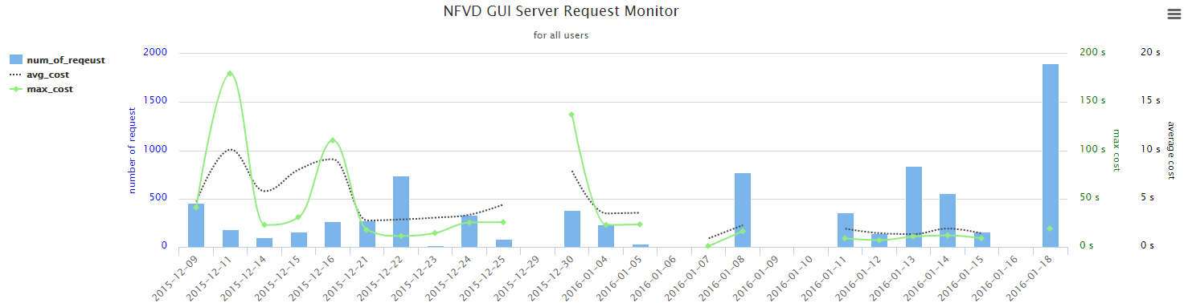
MPM with NFVD
NFVD self monitor
VDC/VAPP Service monitor
Resource Monitor

Slide 18
Next Step
Still lots work to make it a real application
Job Management Module
Product level GUI
Algorithm optimize
Retention
Log System

